Slide 1


Project Exam
A Presentation by Ole Alexander Moa Pettersen
Class: Noroff FEU1
Tutor: Eivind Solberg

Slide 2
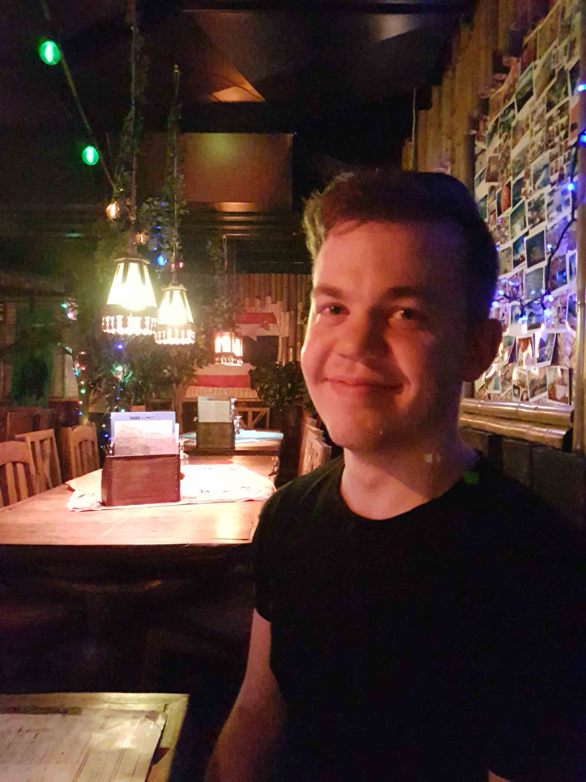
- Ole Alexander Moa Pettersen - Front-End Development Student - 26 years old (in a few days) - Self-proclaimed CSS guru and h4ck3rm4n

Slide 3
The Assignment
Create a Micro Site (4 pages minimum)
Only use basic HTML, CSS and JavaScript
Fully responsive
Respect WCAG/SEO/Accessibility
Focus on NASA, SpaceX or a client
Semantic HTML

Slide 4


Slide 5
The Process
Create a Gantt chart & functional spec
- Research target audience
Create Storyboard & personas
Create Prototype
Weekly meetings to showcase and discuss

Slide 7
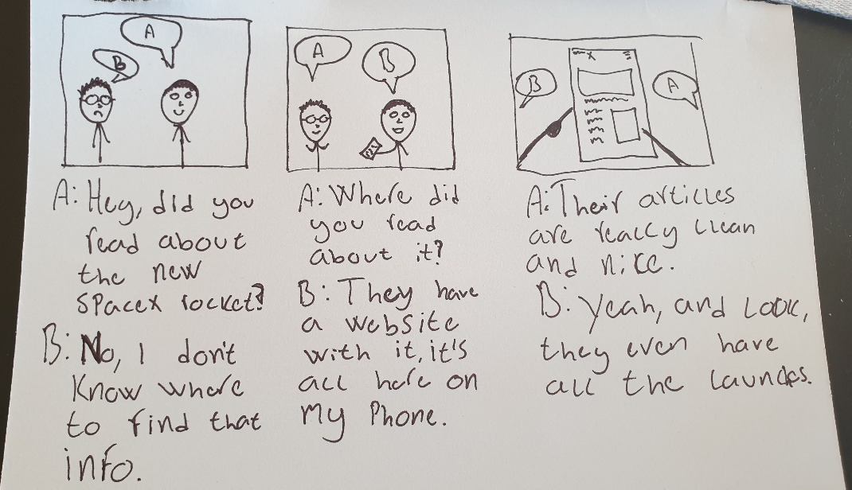

Slide 8
The Coding
- Pure HTML, semantic
SASS (or SCSS) for CSS
Pure JavaScript

Slide 9
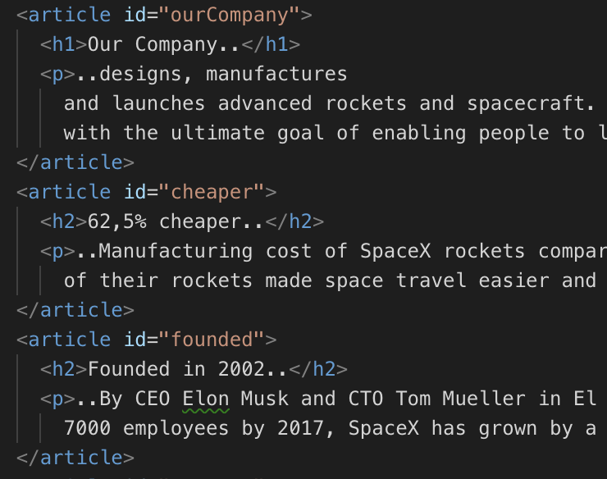

Slide 10
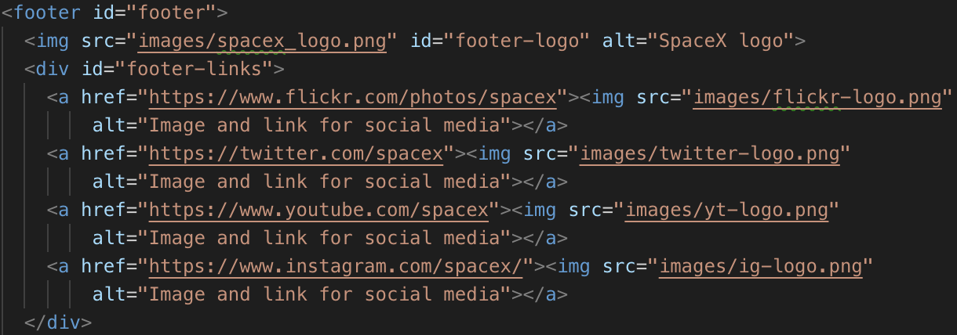

Slide 11
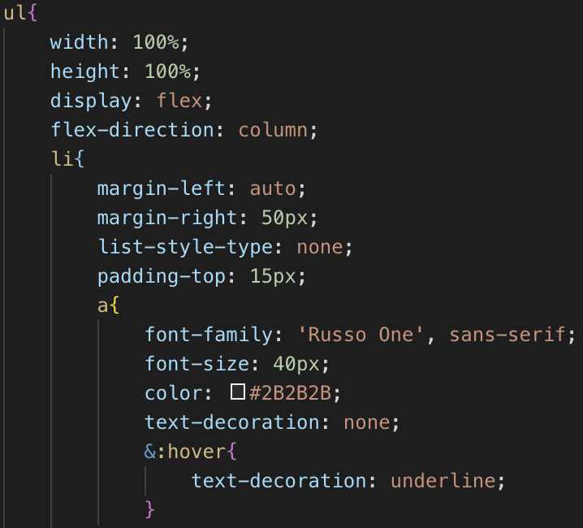

Slide 12
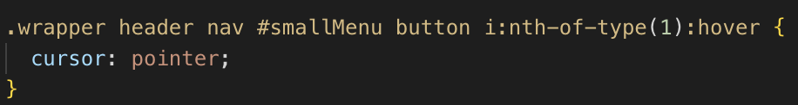
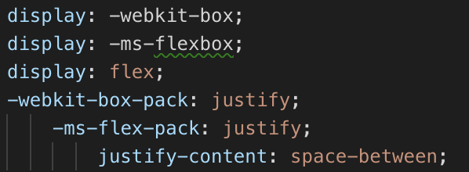

Slide 13
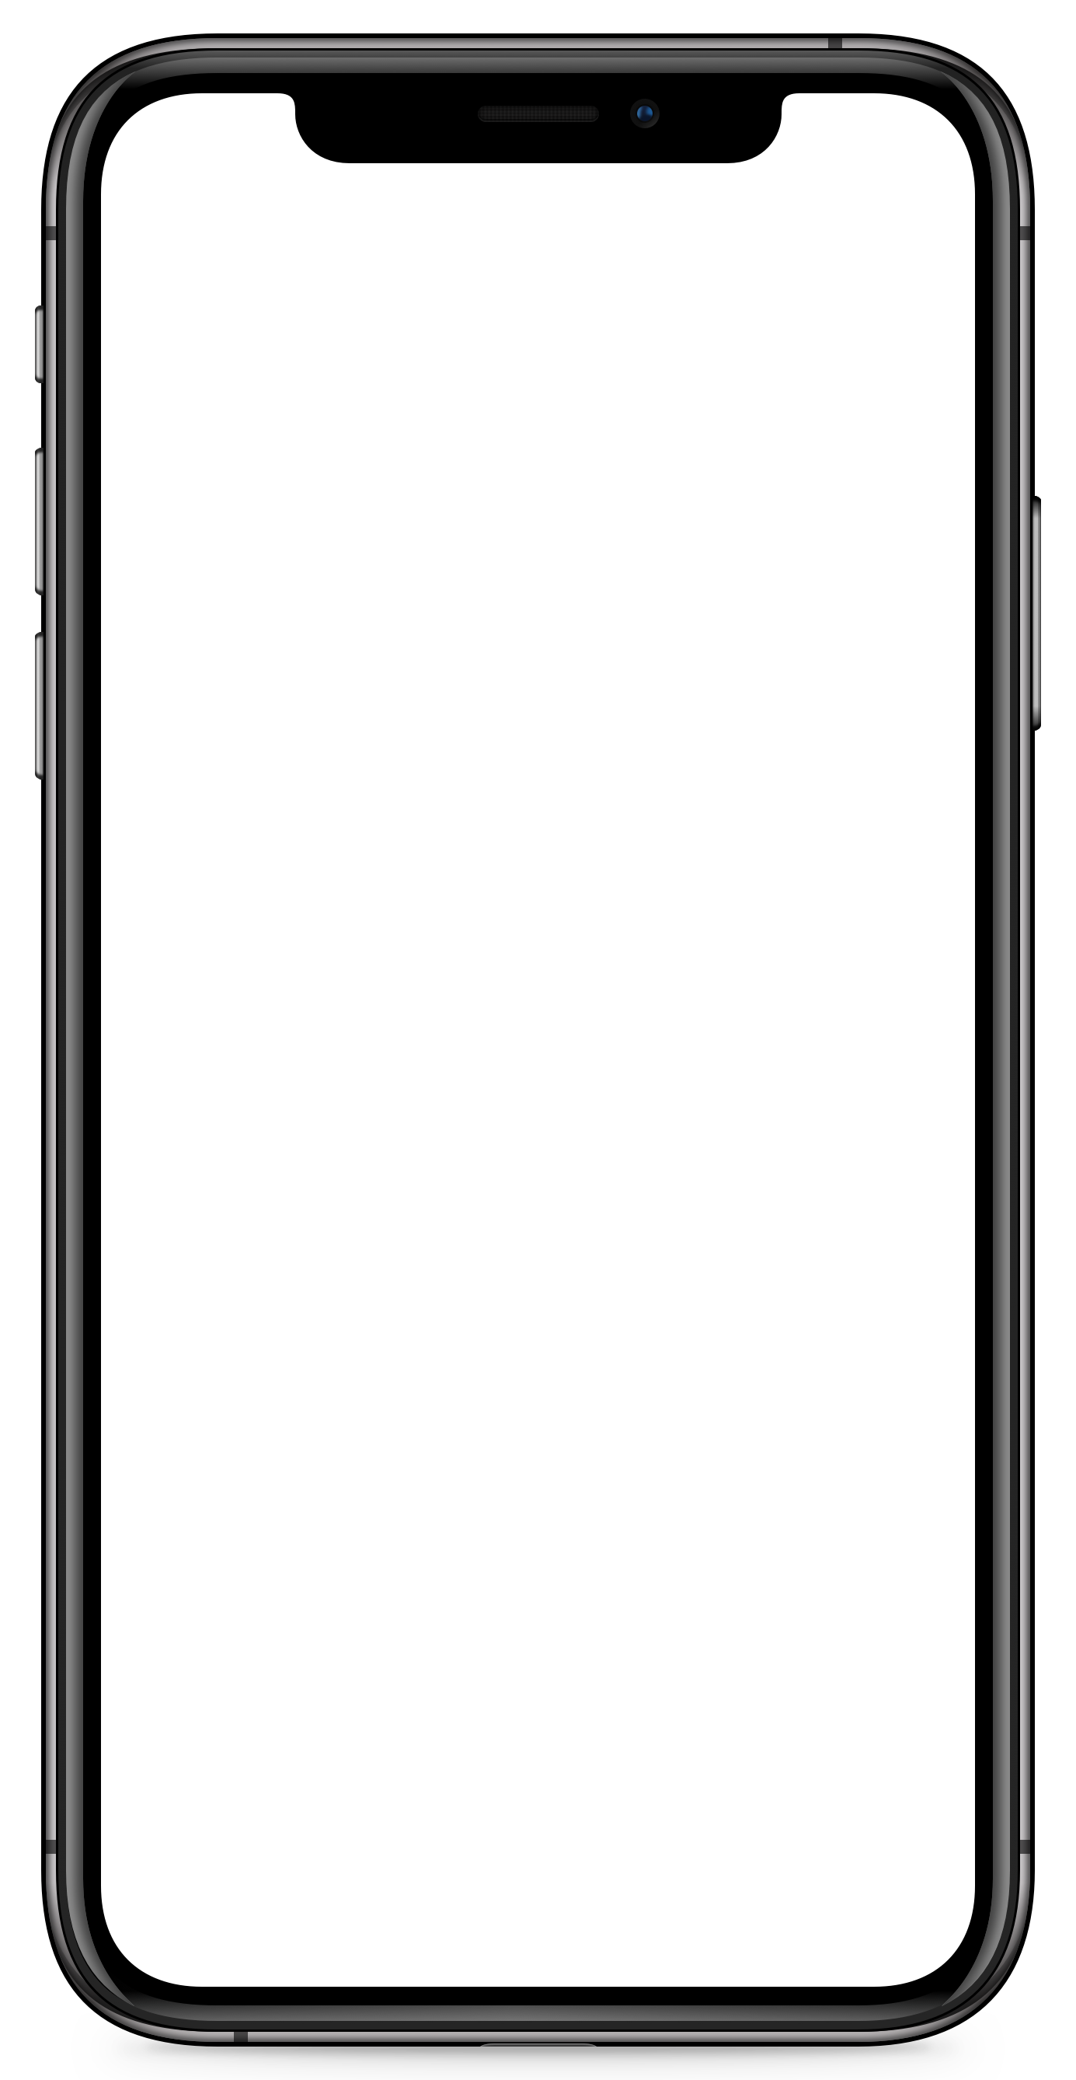
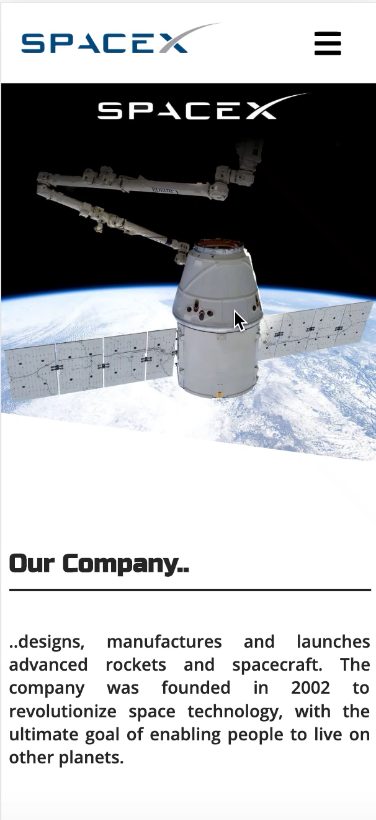

Slide 14

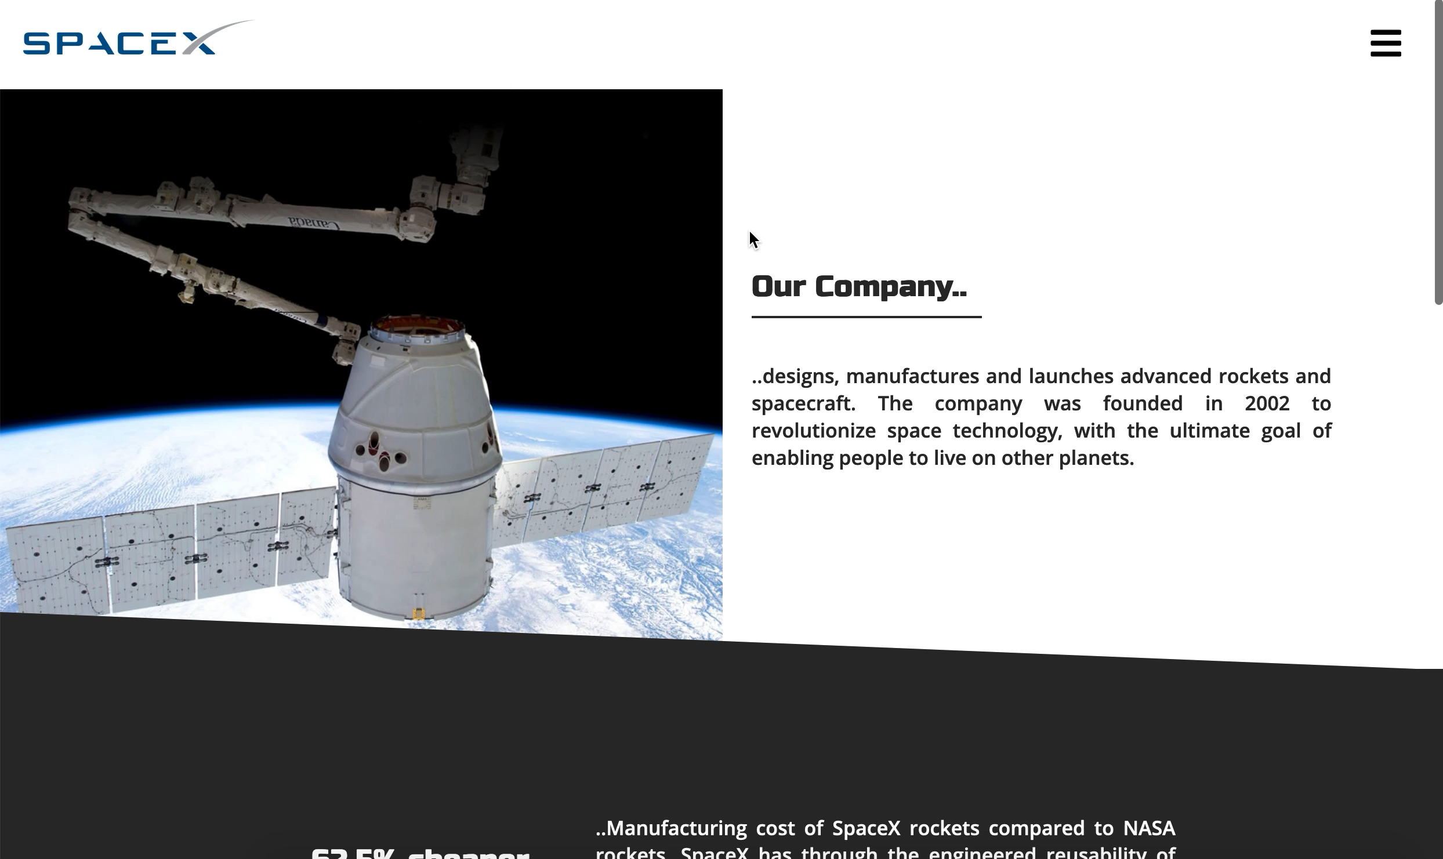

Slide 15
Special thanks to Shabana,
Eivind, Morten, Craig,
René & Alexander

Slide 16
Conclusion
Four pages minimum is much
better than six pages
Creating websites in native HTML, CSS and JavaScript is fun
I can see a clear progression from day one to day last

Slide 17
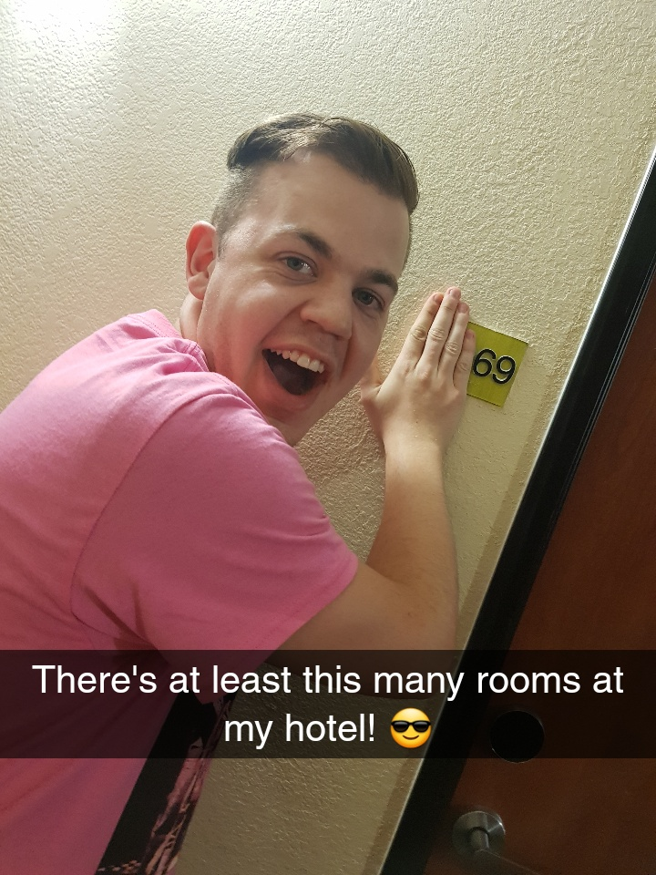
Thank you!

